Slide 1
MOE BERG Baseball Player-Spy

Slide 2
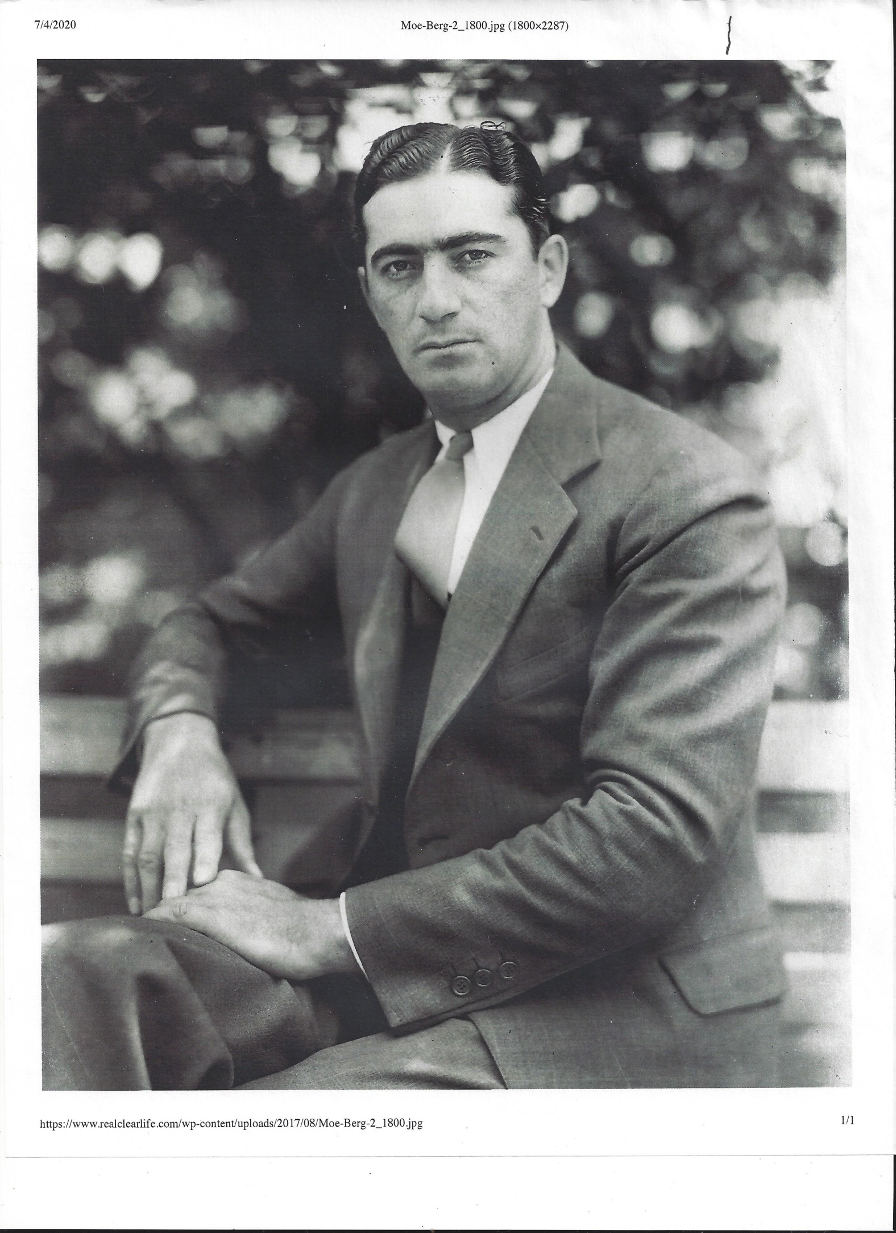

Slide 3
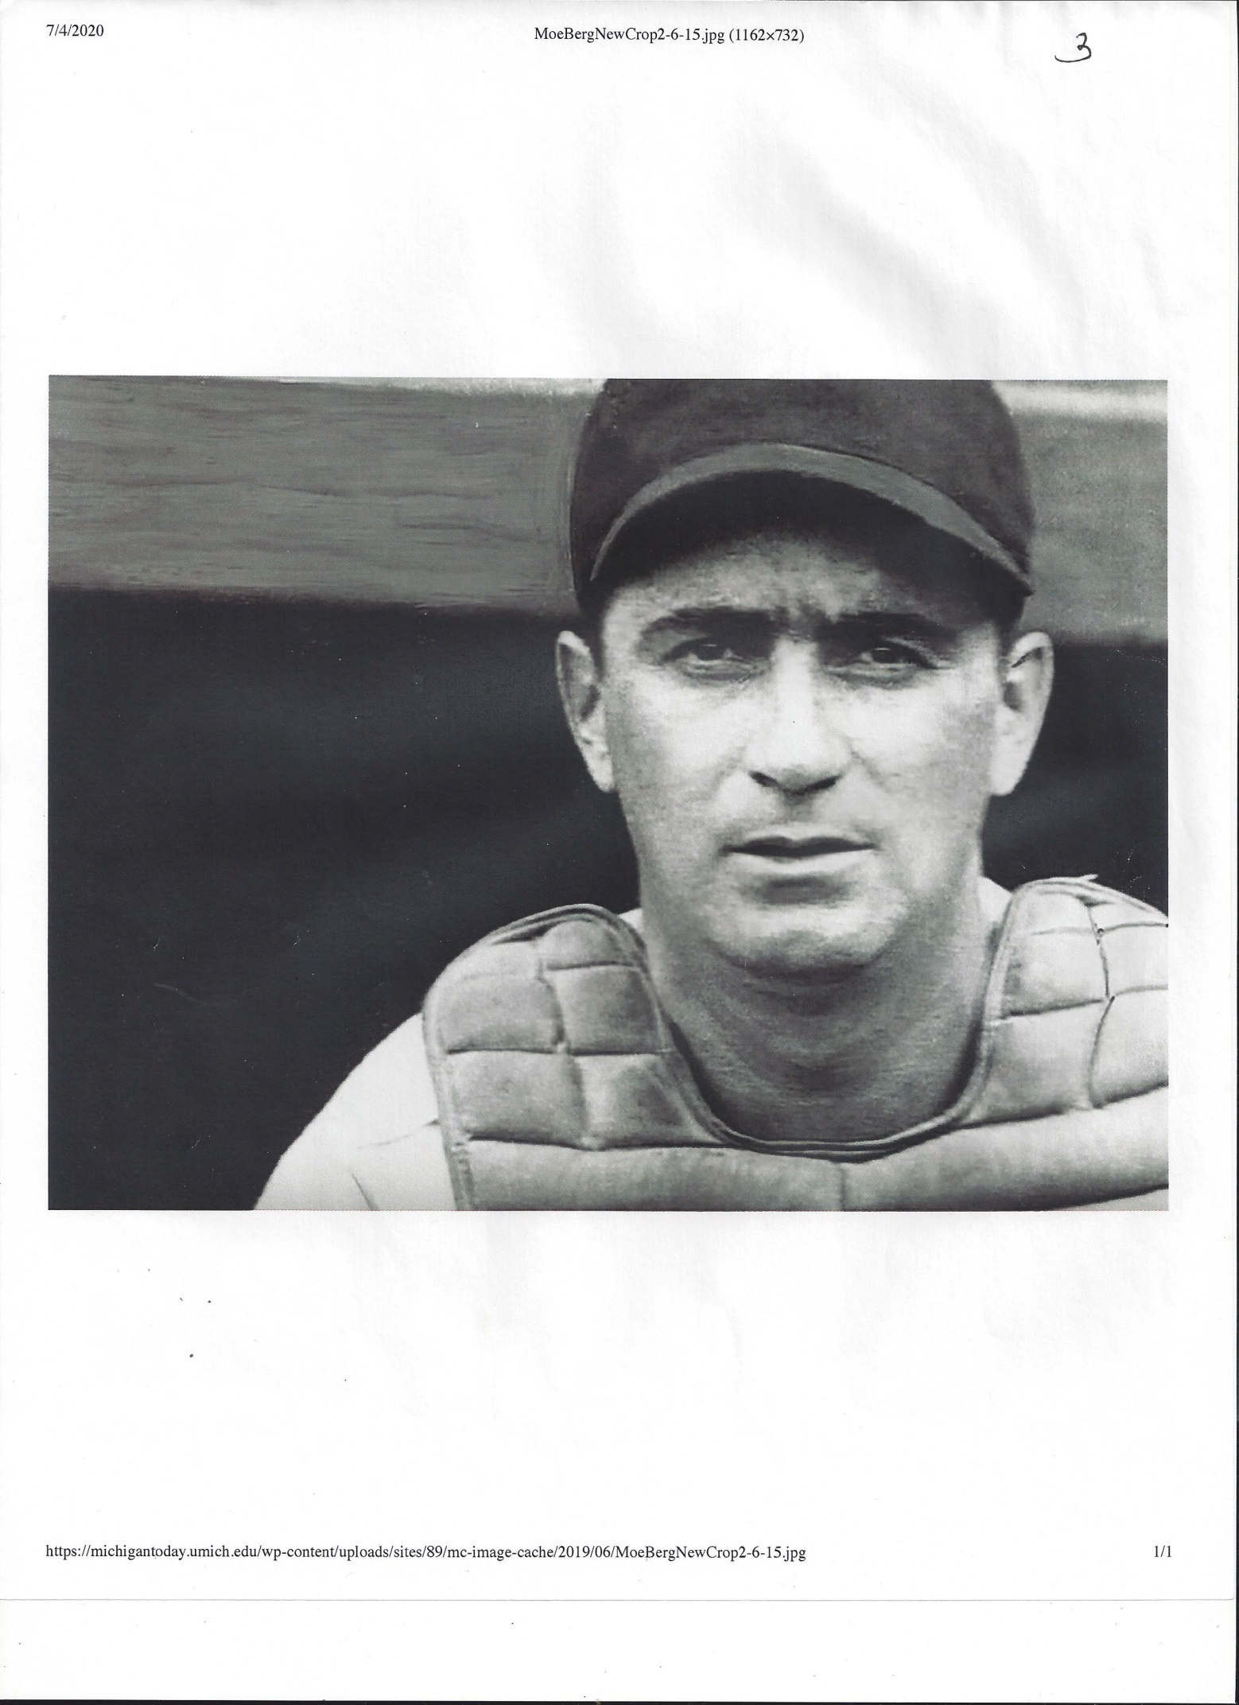

Slide 4
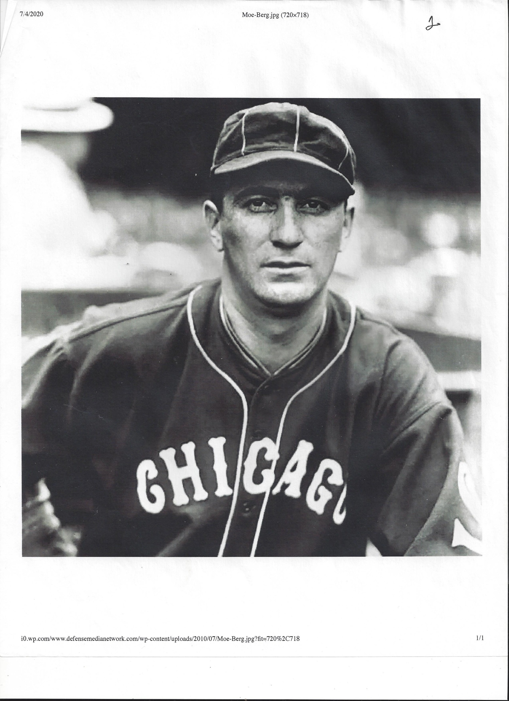

Slide 5
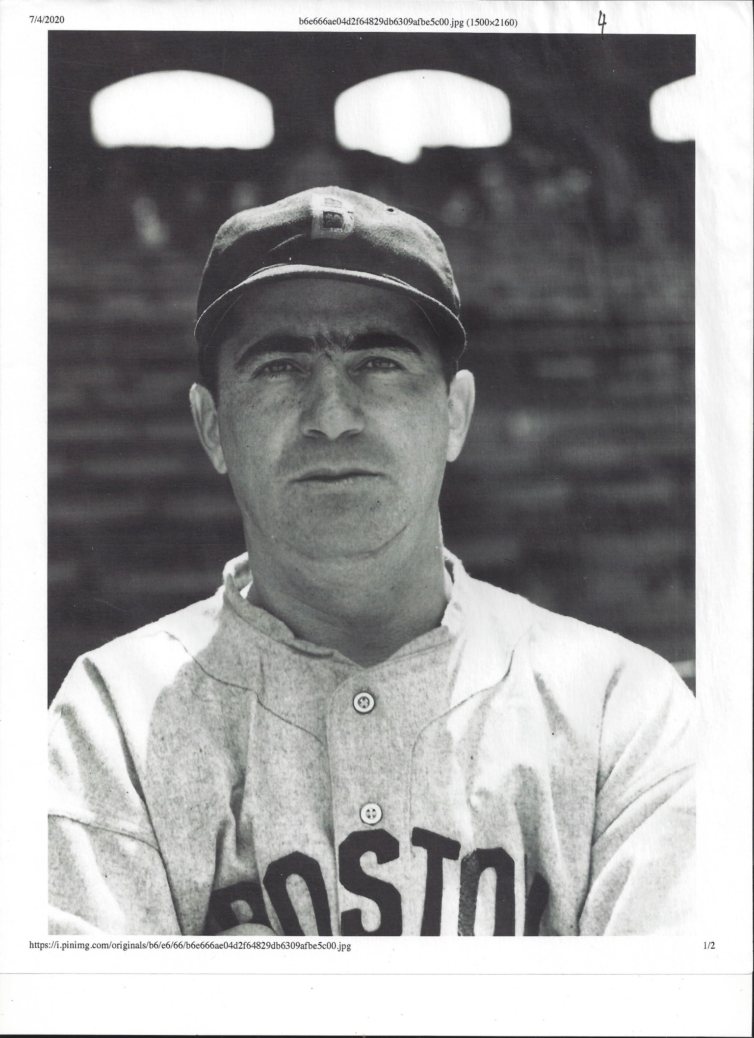

Slide 6
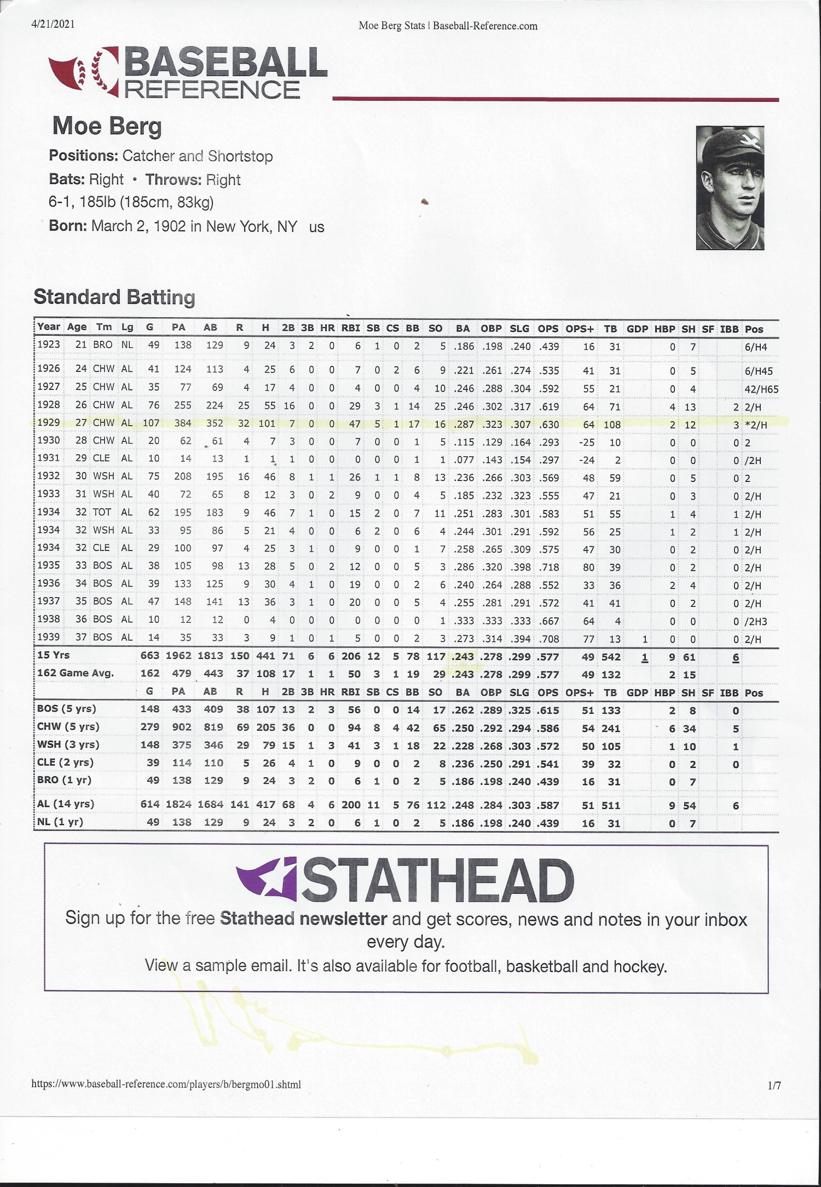

Slide 7
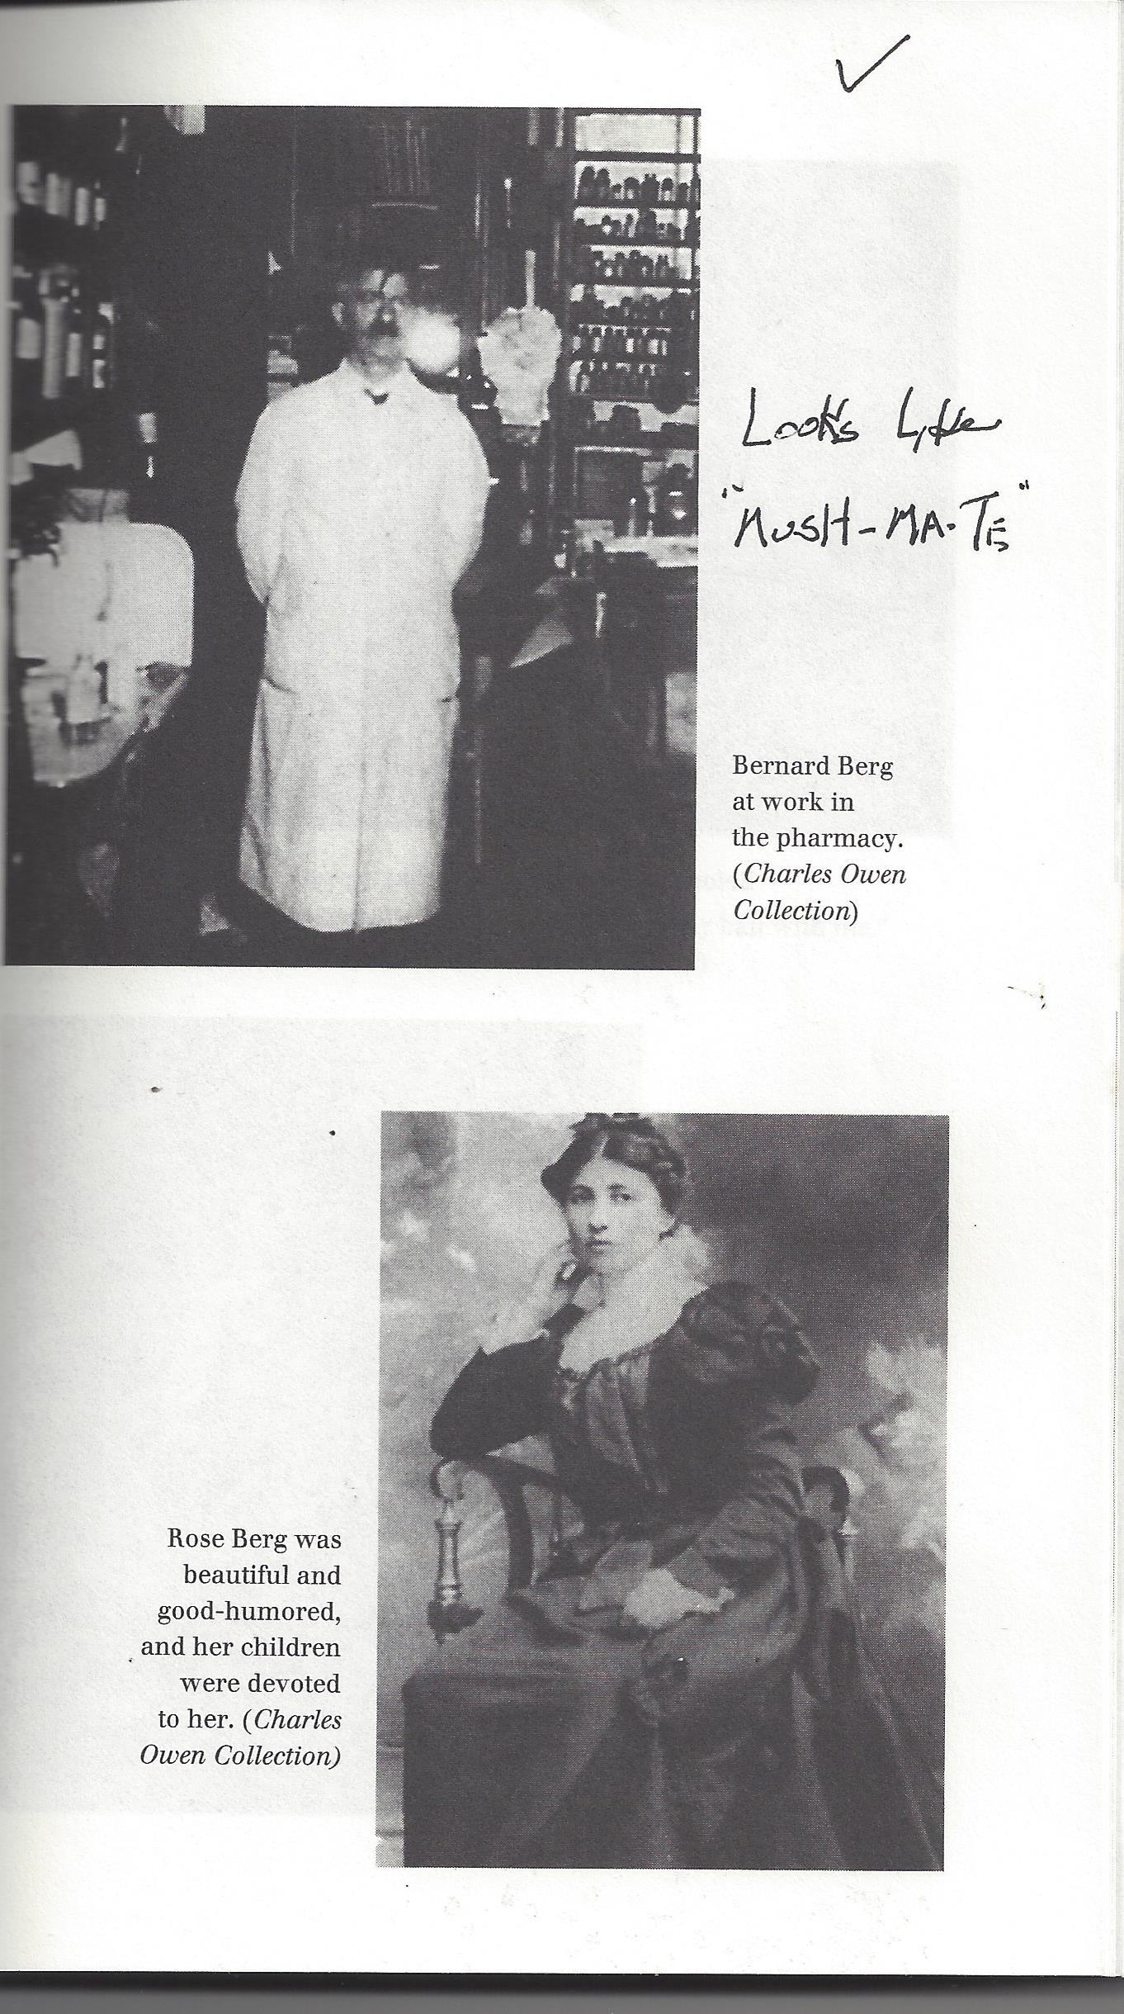

Slide 8
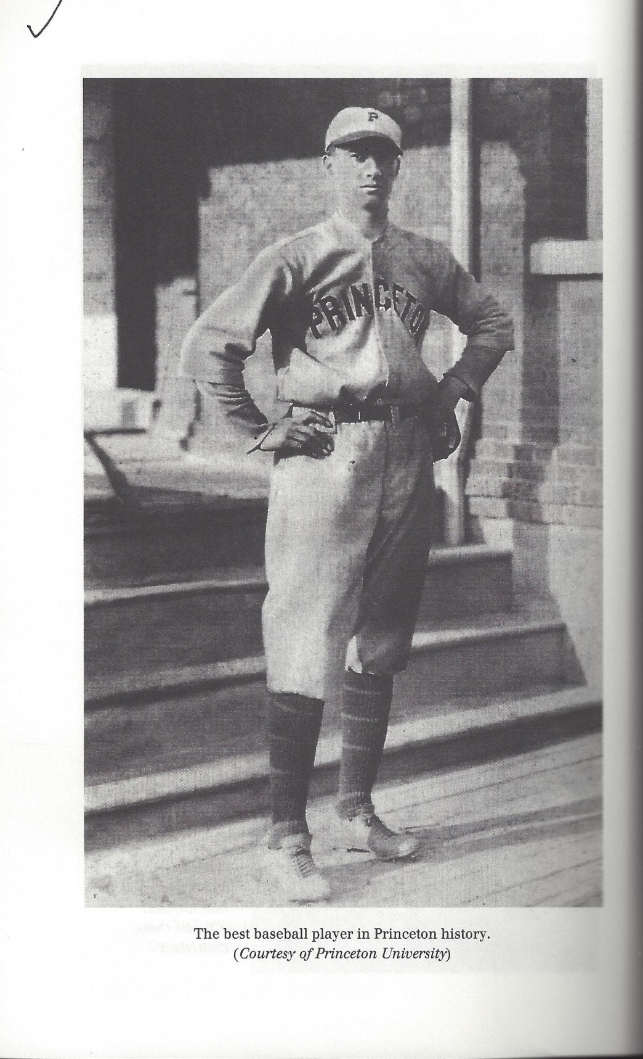

Slide 9
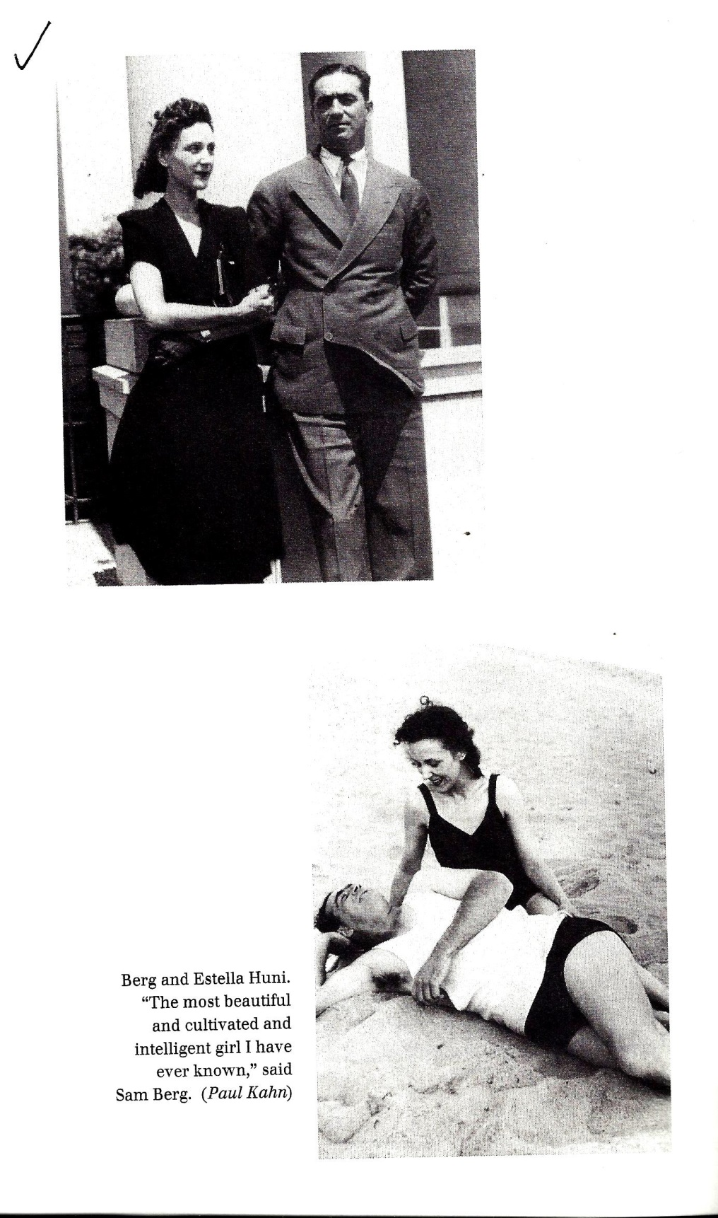

Slide 10
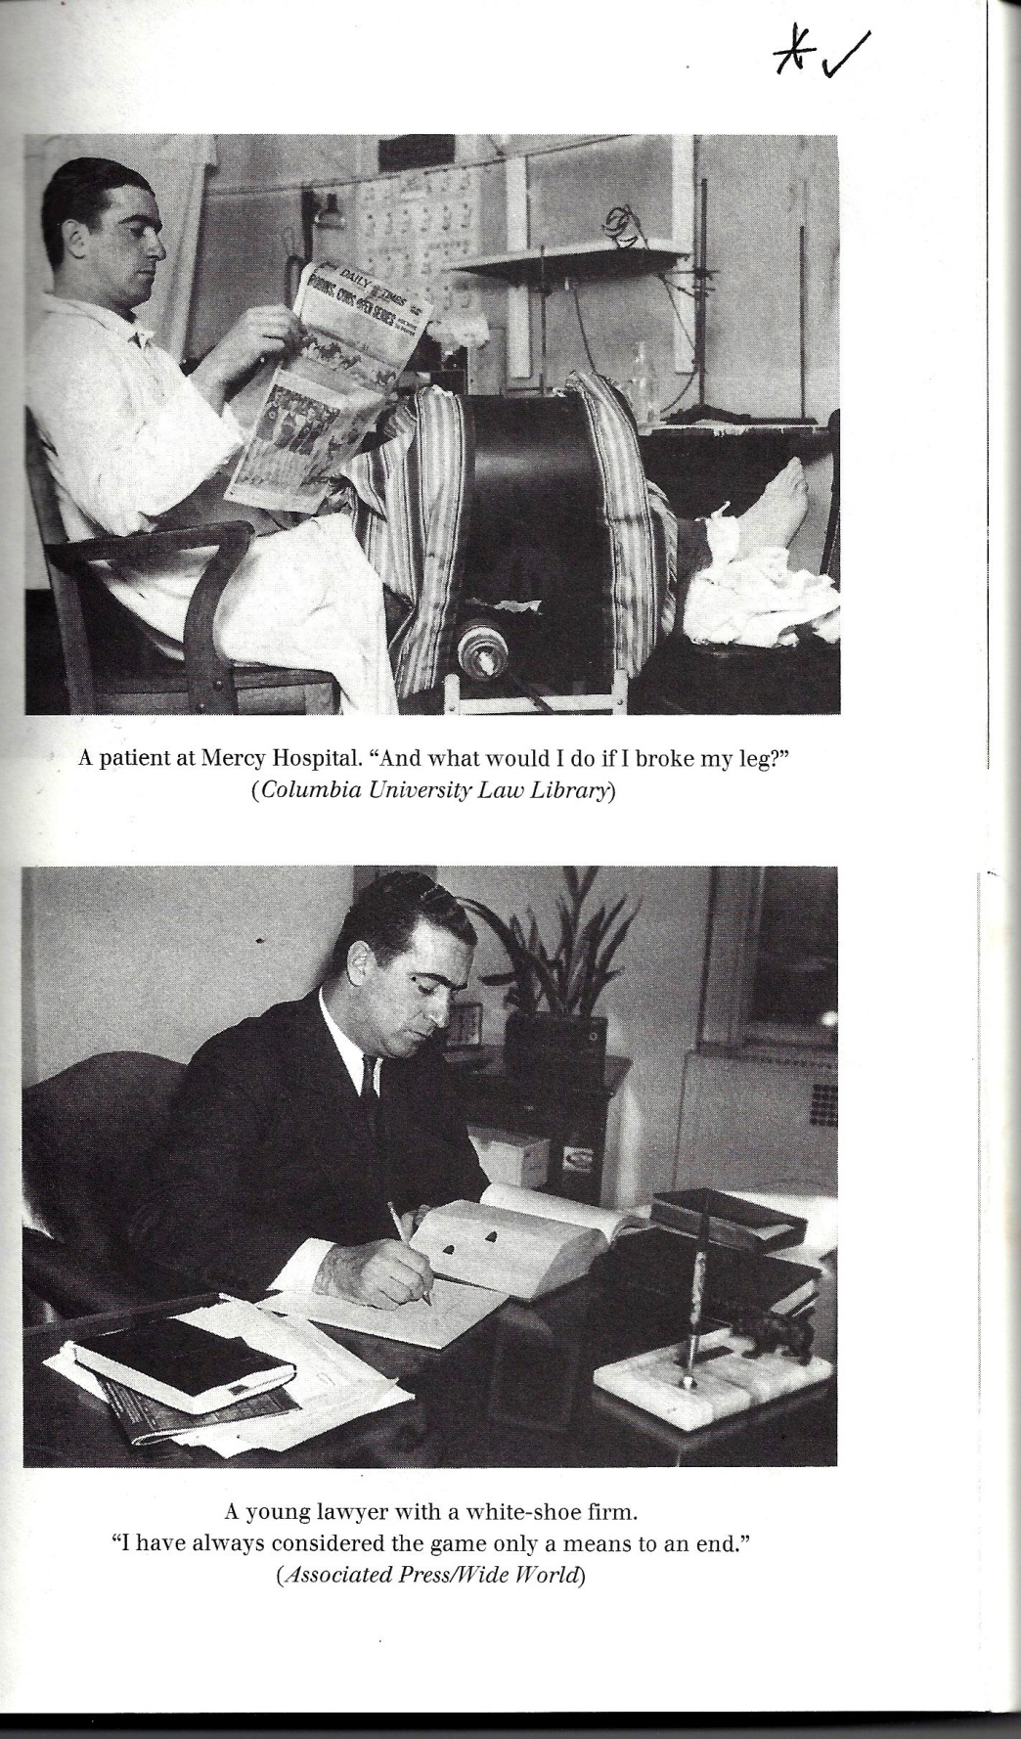

Slide 11
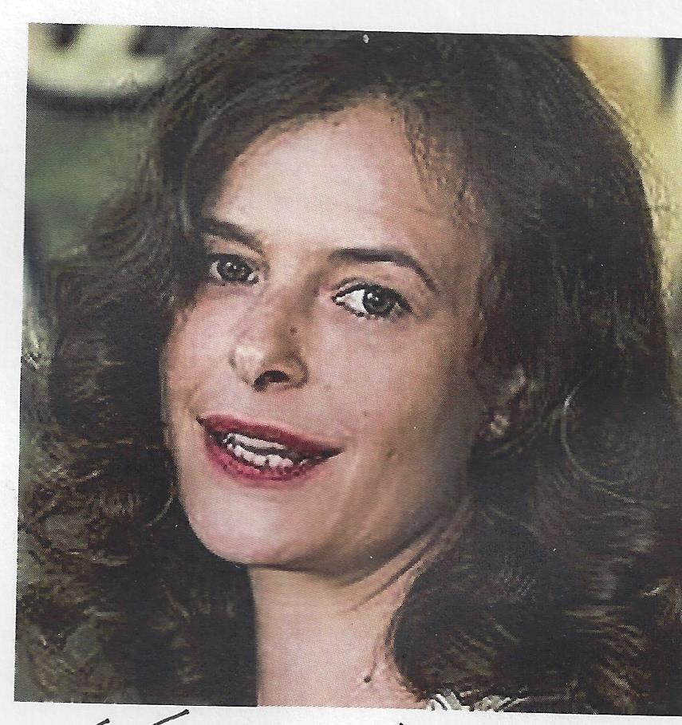

Slide 12
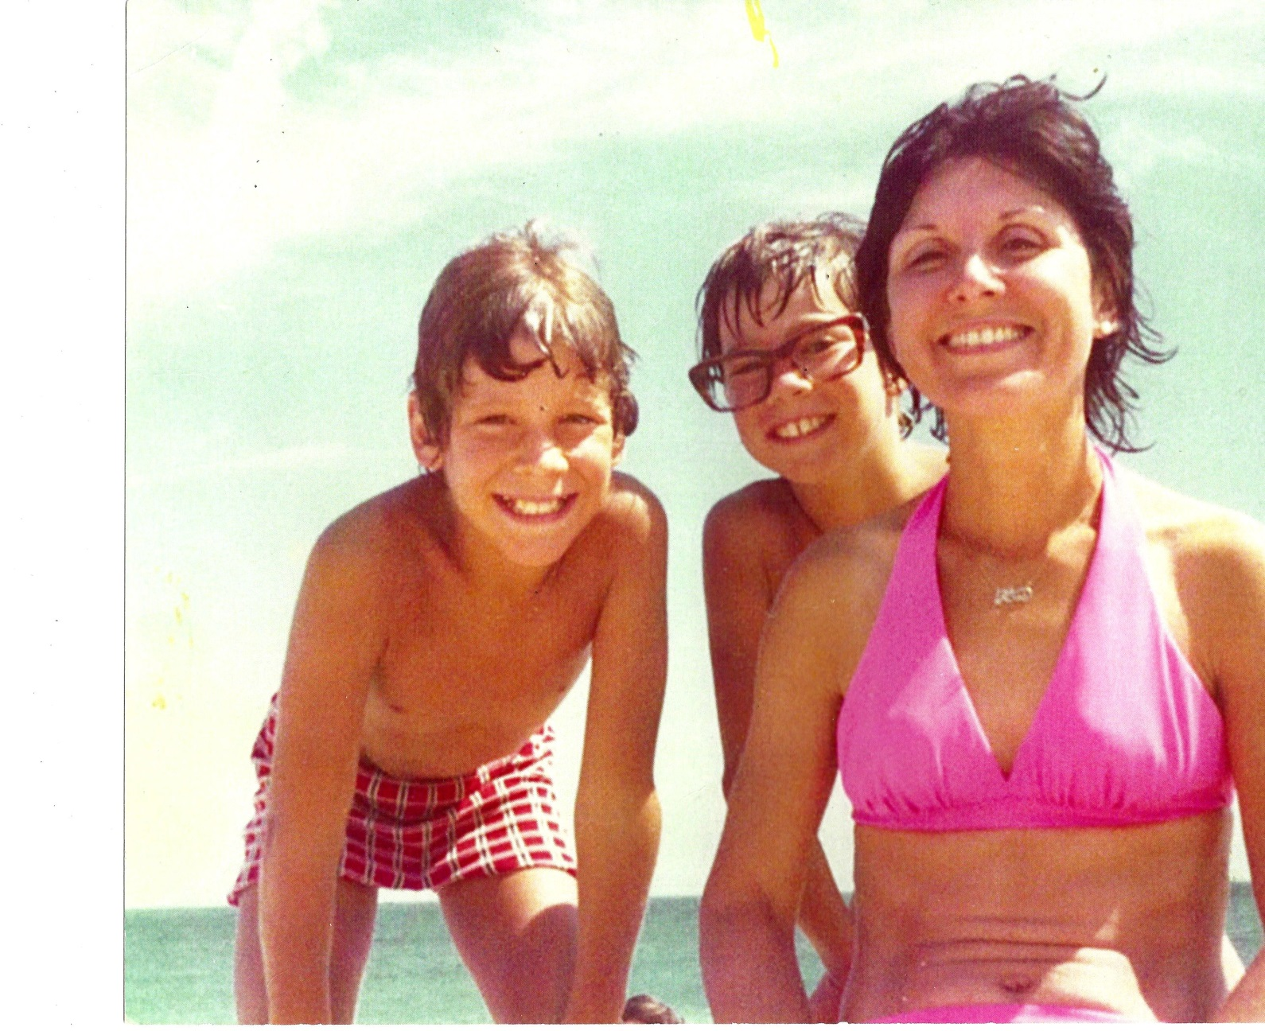

Slide 13
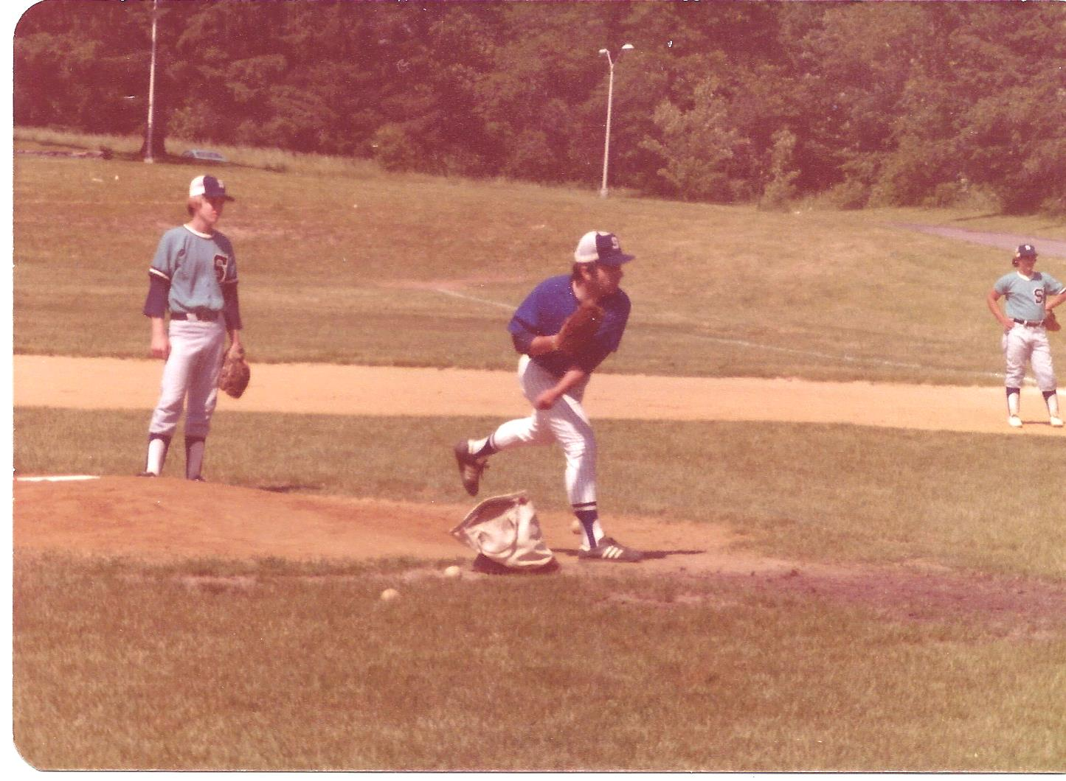

Slide 14
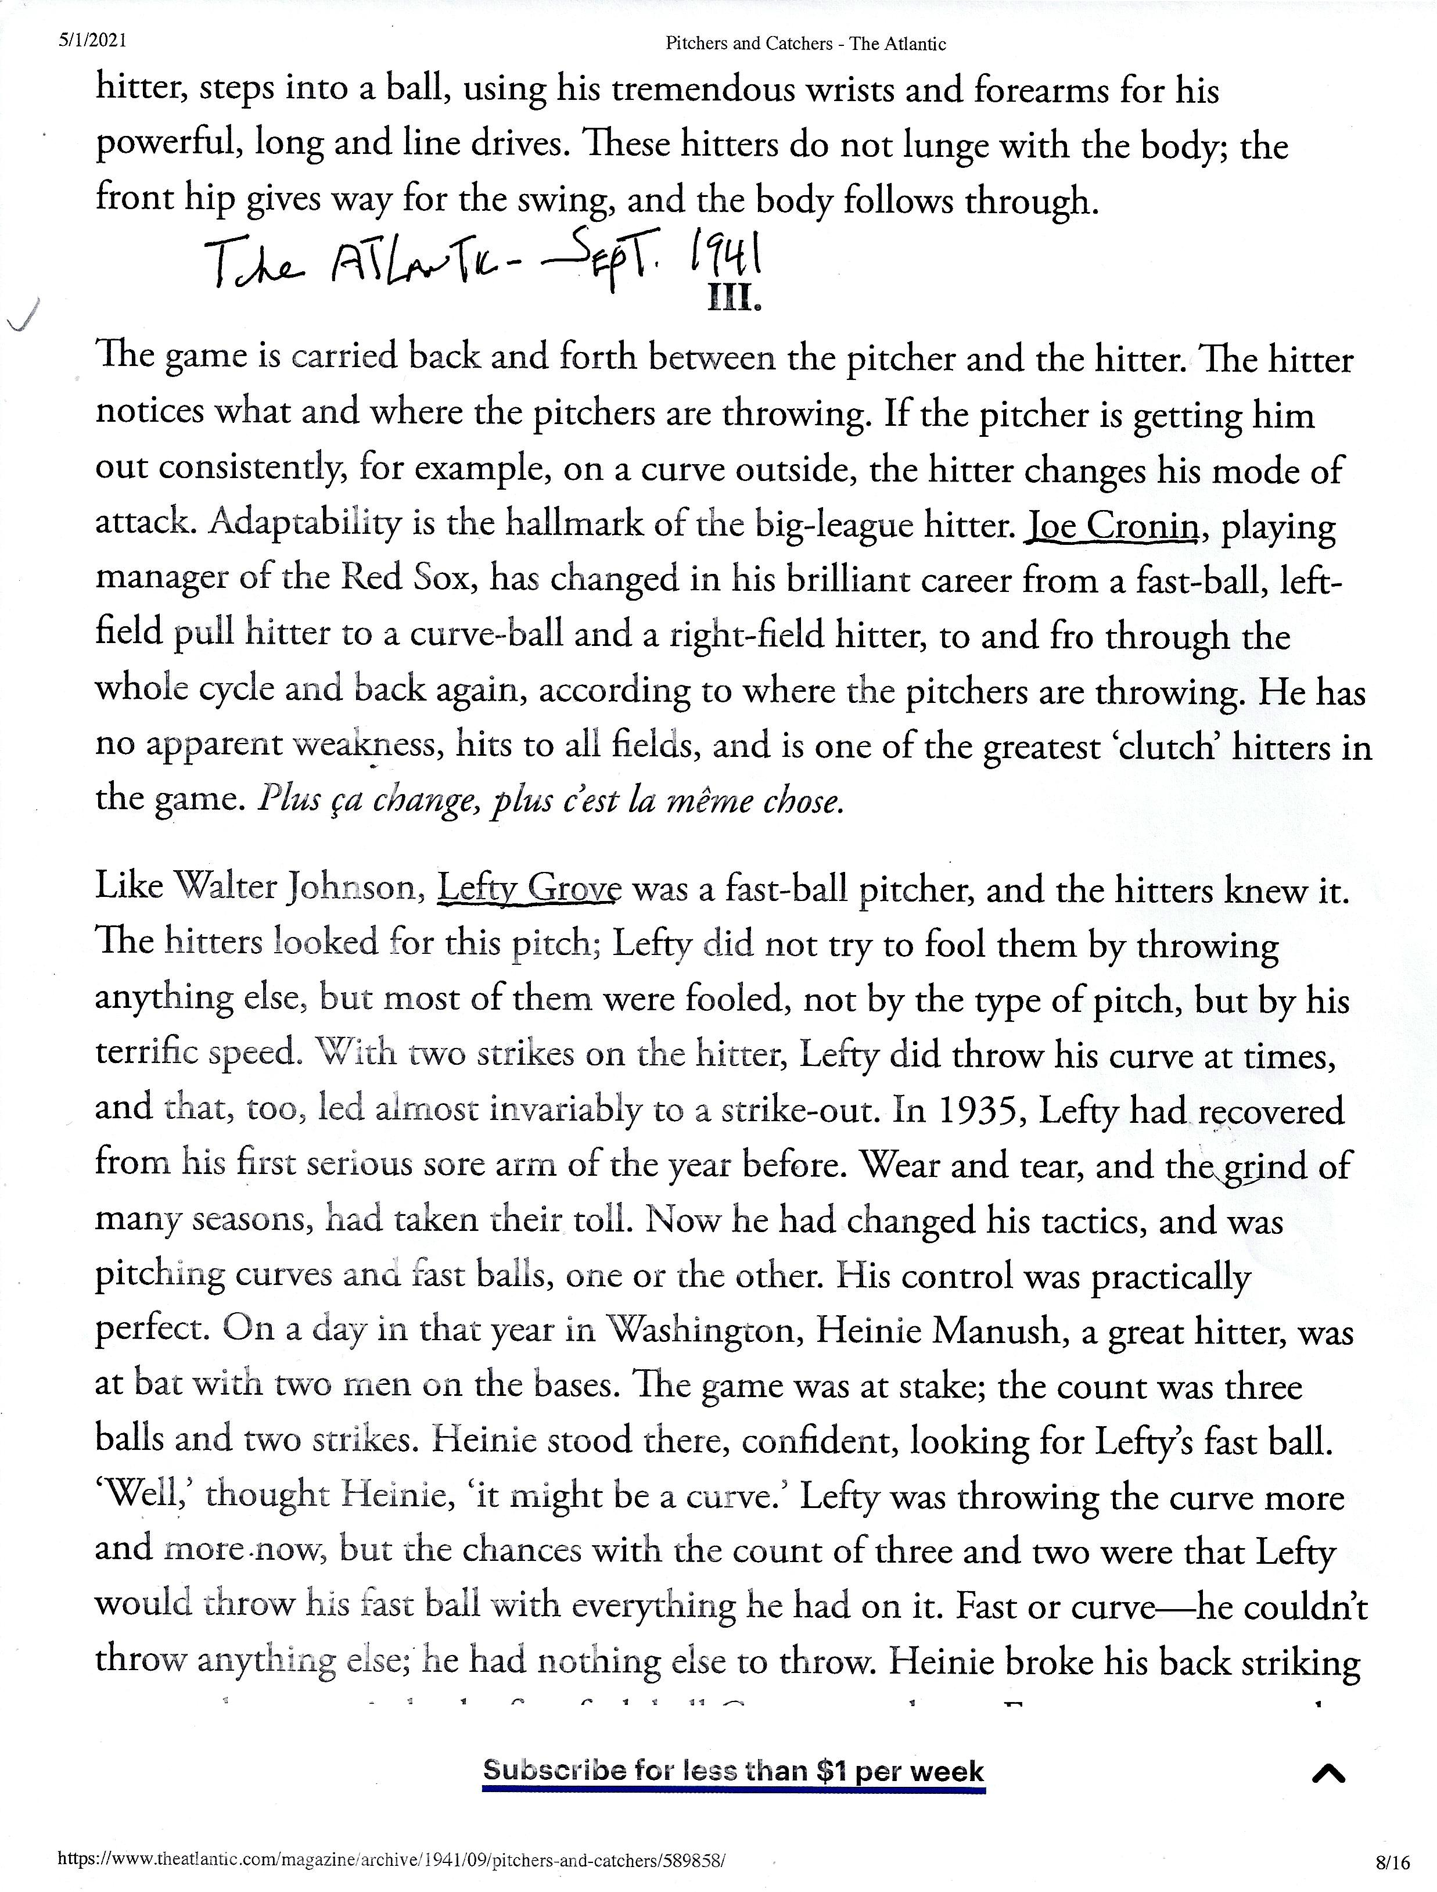

Slide 15
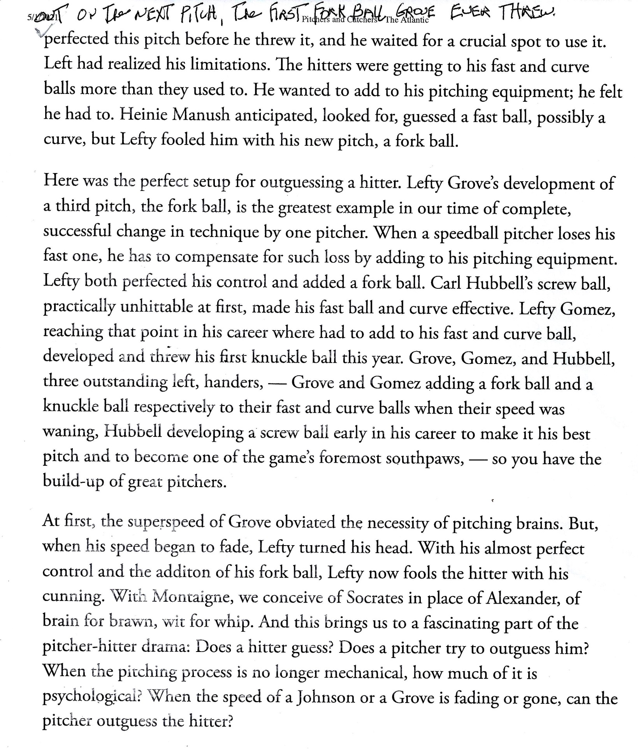

Slide 16
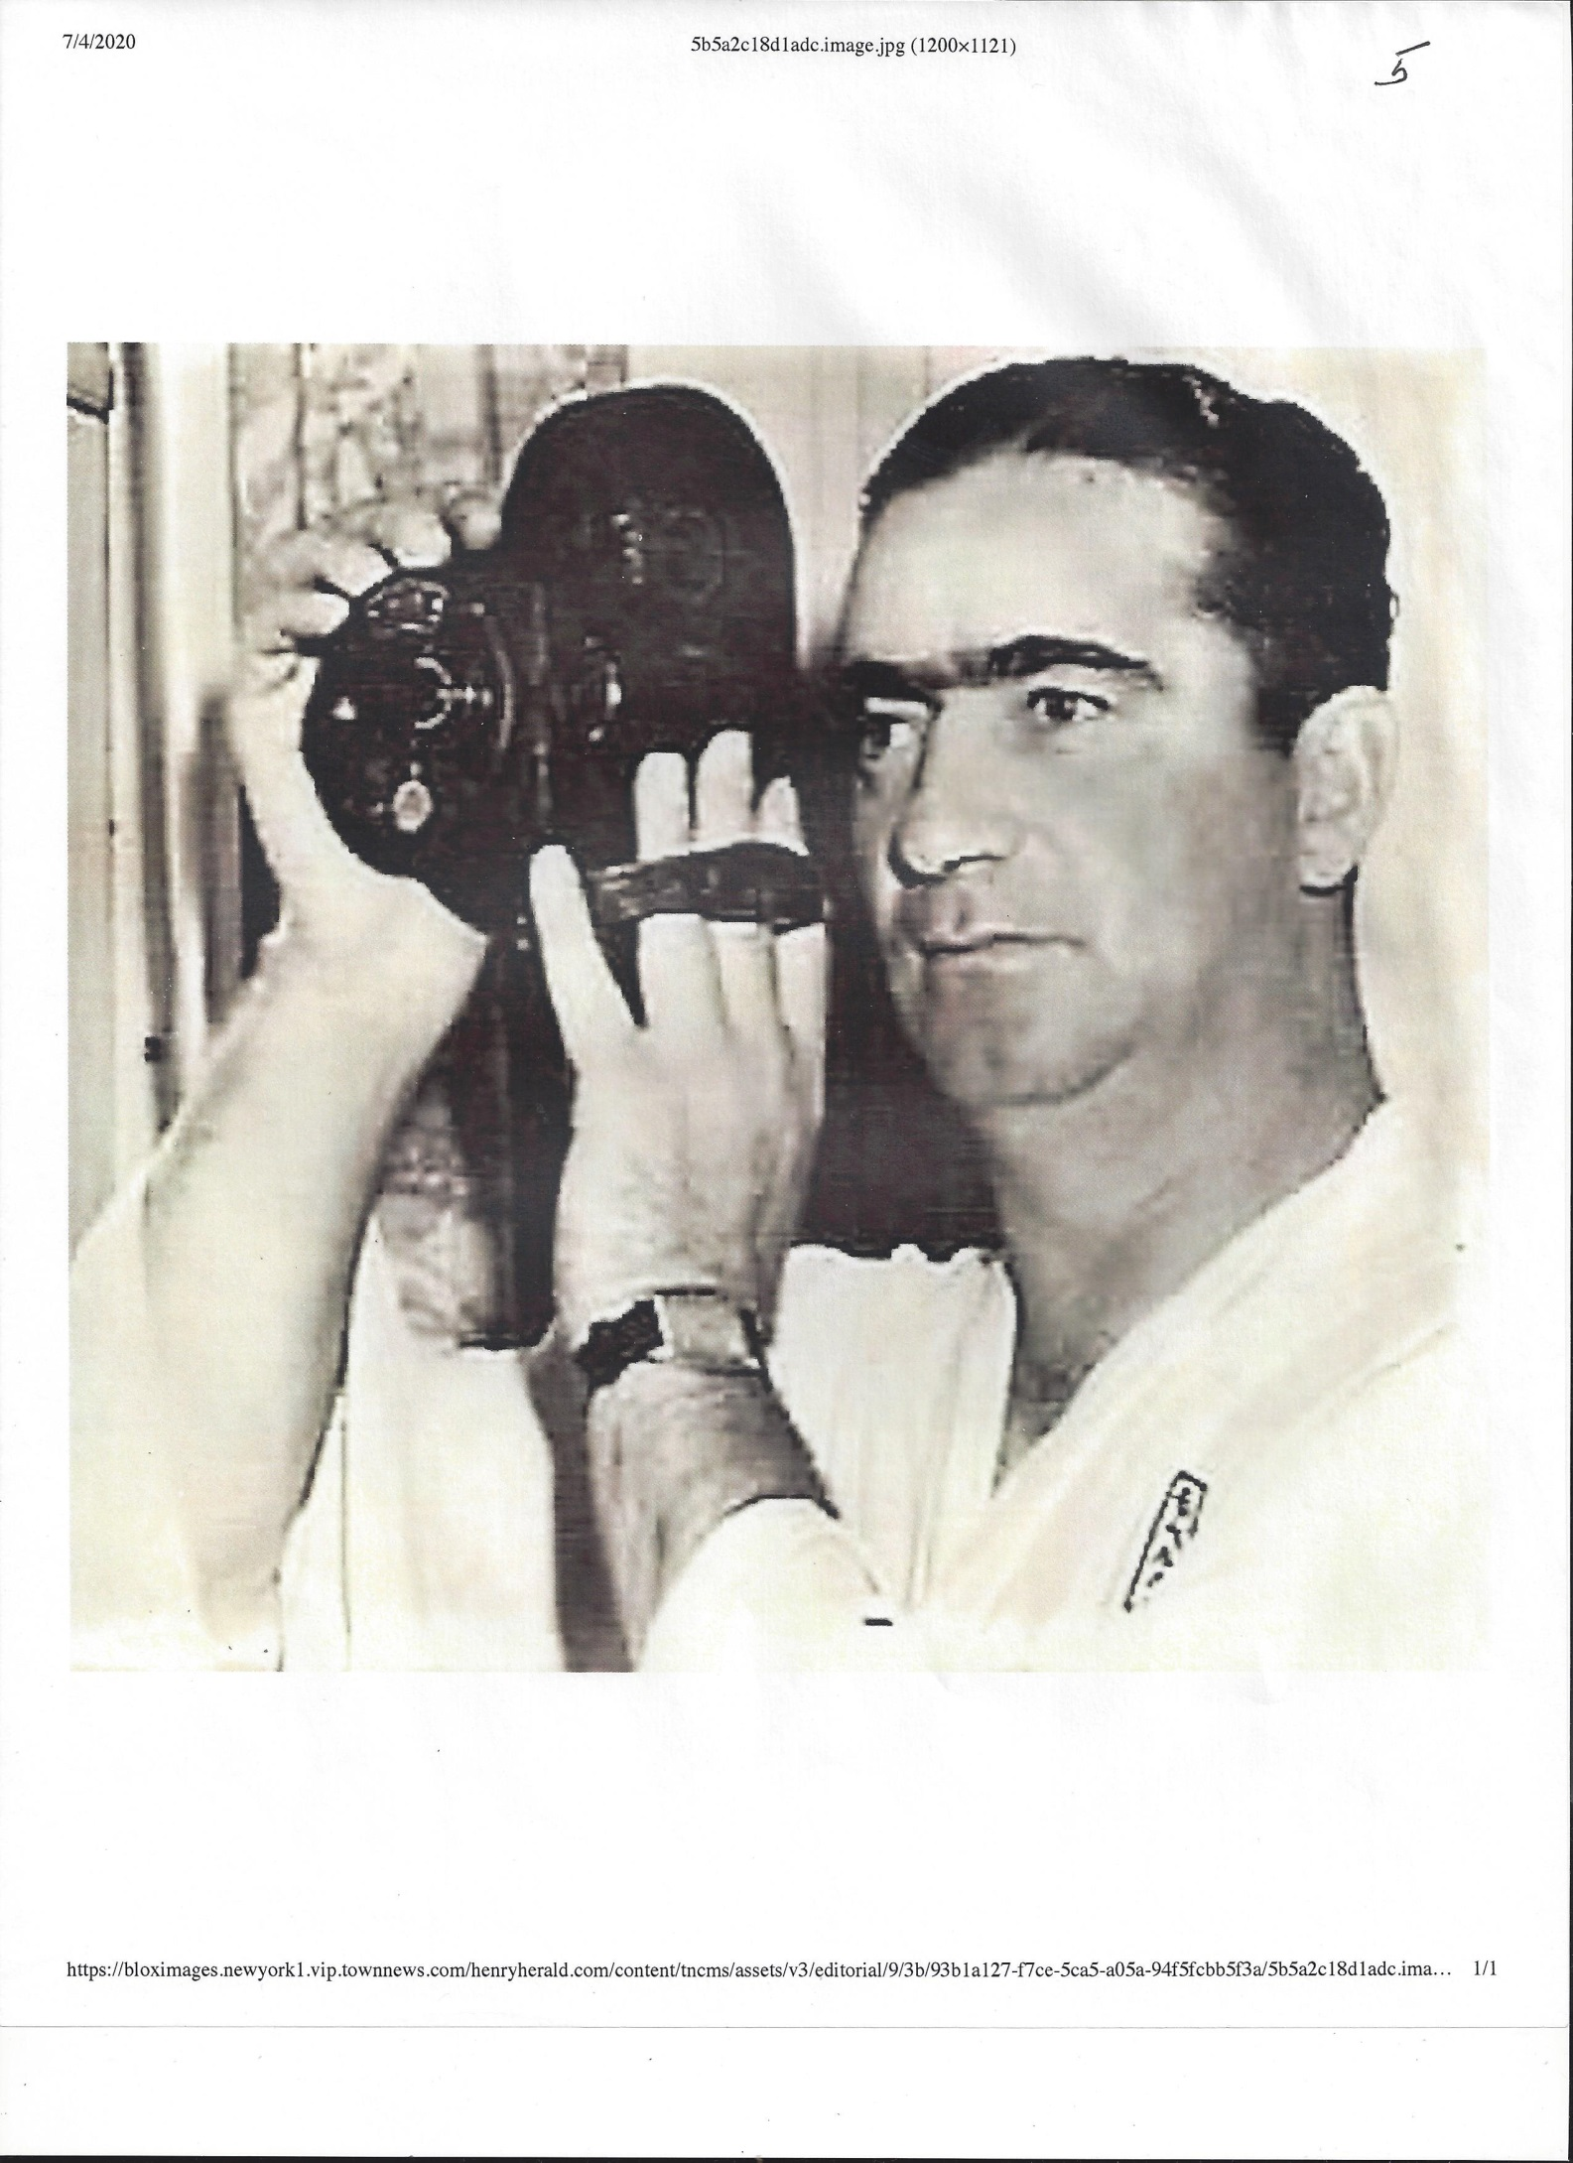

Slide 17
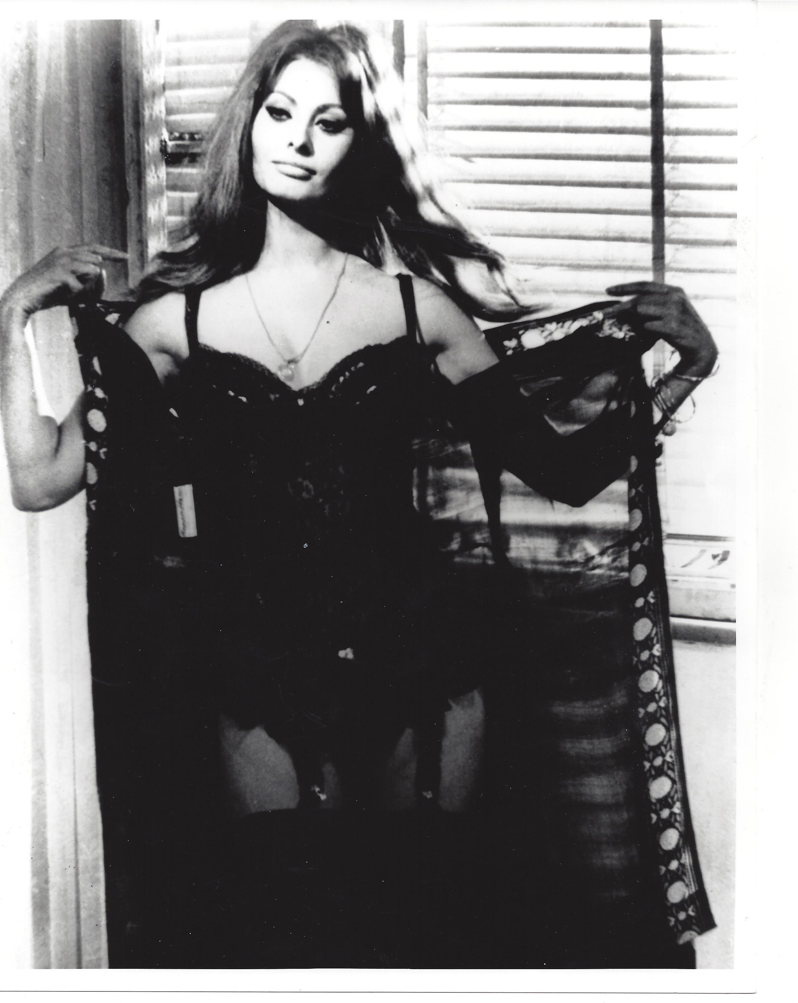

Slide 18
Key moments in Moe’s Life
Eccentric Family
Princeton & Columbia
\
Sorboone
Books and Baseball
1Stella
Japan Trips, 1932 & 1934
Atlantic Monthly Article
“Information Please” Radio Show
Personal Message to Japan
OIAA Assignment and Nelson Rockefeller
OSS Assignment and “Wild Bill” Donovan
Remus" & Rome
Werner Heisenberg
Takizo Matsumoto
Sad Ending

Slide 19
RECOMMENDED YOU TUBE VIDEOS TO WATCH ON MOE BERG
MORRA
https://www.youtube.com/watch?v=VedEqmLFkcA
2. Ira Berkow – On the Mysterious Encounters with Moe Berg
https://www.youtube.com/watch?v=7A7RxVsVZMQ
Sports Century-Moe Burg
https://www.youtube.com/watch?v=vywOwtLisRw

